Slide 1
Pull-Up and
Pull-Down Resistor
Dr. A. Baskar

Slide 2
Introduction
The main function of the resistor is to regulate or limit the flow of electrical current in a circuit.
By providing resistance, resistors help regulate voltage and current, protect other components from excessive current, and set operating conditions for various parts of a circuit.

Slide 3
Cont…
Digital logic gates, micro-controllers and IC’s contain many input and output pins. These input and output pins should be correctly set to the either HIGH or LOW state for the digital circuit to function correctly.
These logic states are represented by two different voltage levels with any voltage below one level is regarded as logic “0” and any voltage above another level is regarded as logic “1”.
If the input to a digital logic gate is not within the range by which it can be sensed as either logic 0 or a logic 1, then the circuit may falsely trigger and the desired result cannot be obtained.

Slide 4
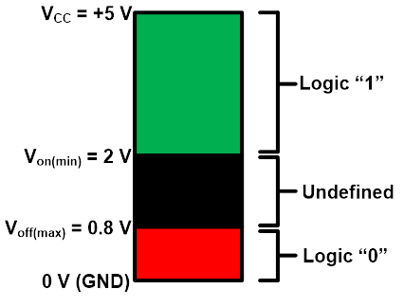
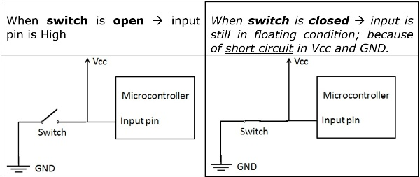
Key challenges
A digital circuit has three input logic states; High (1), Low (0), and floating (undefined).
But the digital circuit only operates in high or low states.
In a floating state, the digital circuits may confuse between high and low.
Consider a digital circuit operating on 5 V. If the input voltage is between 2 to 5 V, the input logic of the circuit is high.
And if the input voltage is less than 0.8 V, the input logic is low.
When the input voltage ranges from 0.9 to 1.9 V, the circuit struggles to determine a clear state.
To prevent such scenarios, digital circuits employ pull-down or pull-up resistors.

Slide 5
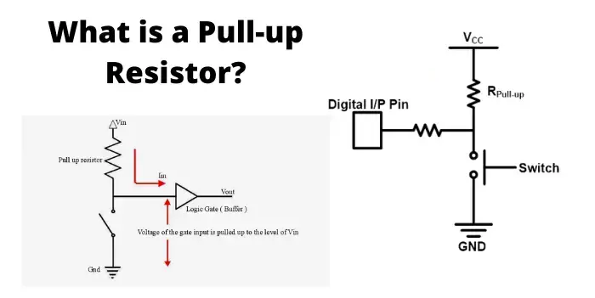
Pull up resistor
A pull-up resistor is a resistor used in electronic circuits to ensure that a signal line is at a defined logic high level (usually Vcc) when no other active device is driving it.
A pull-up resistor is a resistor connected between a signal line (or input pin) and the positive supply voltage (Vcc).
Its primary purpose is to ensure that the signal line is at a high logic level (logical '1') when no other device is actively pulling it low.
A pull-up resistor "pulls" the voltage up to HIGH, giving the input a stable and known state.

Slide 6
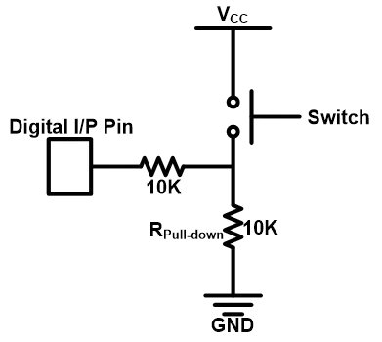
Pull down resistor
A pull-down resistor is a resistor connected between a signal line (e.g., GPIO pin) and ground (GND). Its main function is to ensure the signal reads a logic LOW (0) when no other active device is driving the line.
A pull-down resistor provides a default logic state of LOW.
When the switch is open: the resistor connects the pin to GND → logic LOW.
When the switch is closed: the pin is connected to Vcc (HIGH) → resistor is overridden.

Slide 7


